Slide 1
SWITCHING THEORY AND LOGIC DESIGN
UNIT-3
BY
S.SAGAR KRISHNA,
ASSISTANT PROFESSOR,
GAYATRI VIDYA PARISHAD COLLEG OF ENGINEERIN(A)

Slide 2
BCD TO EXCESS-3 CONVERTER
Procedure:
Write the functional table.
Using K-MAP get the Boolean expressions for each output.
Draw the logic diagram.

Slide 3
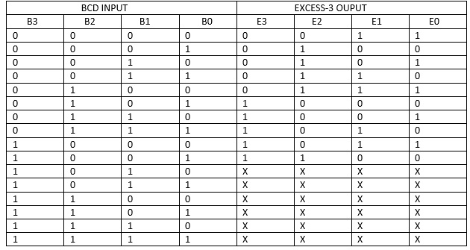
BCD TO EXCESS-3 CONVERTER
Functional Table:

Slide 4
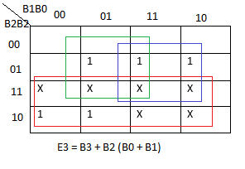
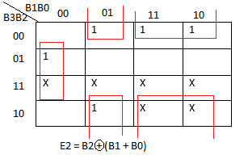
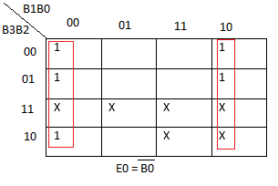
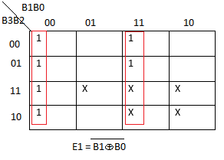
BCD TO EXCESS-3 CONVERTER
Boolean expressions for each output:

Slide 5
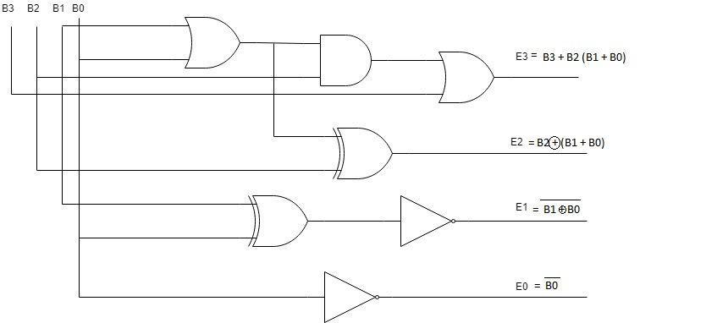
BCD TO EXCESS-3 CONVERTER
logic diagram :

Slide 6
Decoders
A decoder has
N inputs
2^{N} outputs
A decoder selects one of 2^{N} outputs by decoding the binary value on the N inputs.
The decoder generates all of the minterms of the N input variables.
Exactly one output will be active for each combination of the inputs.

Slide 7
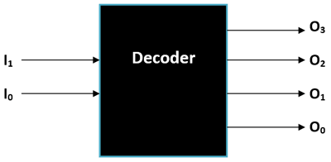
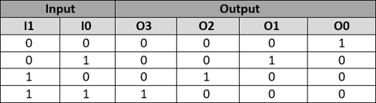
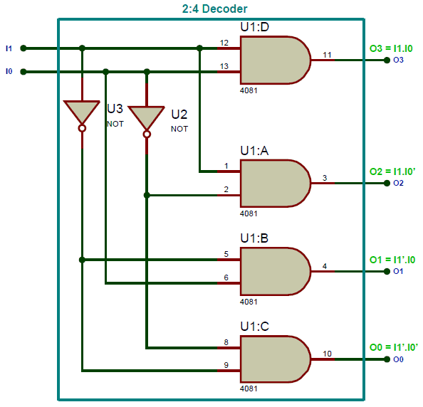
2x4 Decoder:
Functional Table of 2x4 Decoder
Logic Diagram

Slide 8
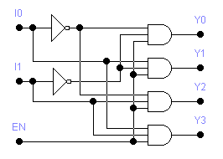
2x4 decoder with enable:
Logic Diagram
Inputs | Outputs
EN I1 I0 | Y3 Y2 Y1 Y0
0 X X 1 0 0 1 0 1 1 1 0 1 1 1 | 0 0 0 0 0 0 0 1 0 0 1 0 0 1 0 0 1 0 0 0
Functional Table

Slide 9
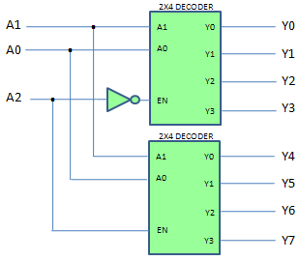
3x8 decoder using 2x4 decoder
The inputs A0 and A1 is connected as parallel inputs for both the decoders and then the Enable pin of the Second Decoder is made to act as A2 (third input).
The Inverted signal of A2 is given to the Enable pin of first decoder to get the outputs Y0 to Y3. Here the outputs Y0 to Y3 is referred as Lower four minterms and the outputs Y4 to Y7 is referred as higher four minterms.
The lower order minterms are obtained from the first decoder and the higher order minterms are obtained from the second decoder.
Logic Diagram

Slide 10
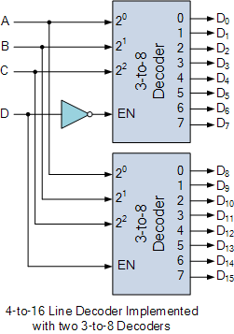
4x16 decoder using 3x8 decoder

Slide 11
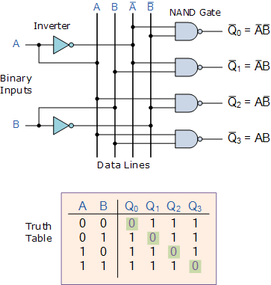
2x4 decoder with active low output

Slide 12
Encoders
An encoder has
2^{N} inputs
N outputs
An encoder outputs the binary value of the selected (or active) input.
An encoder performs the inverse operation of a decoder.
The encoder can be implemented with OR gates whose inputs are determined directly from the truth table. Output z is equal to 1 when the input octal digit is 1, 3, 5,or 7. Output y is 1 for octal digits 2, 3, 6, or 7, and output x is 1 for digits 4, 5, 6, or 7.

Slide 13
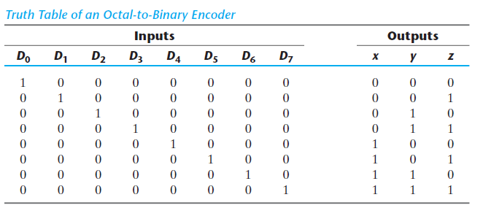

Octal to Binary Encoder
Output z is equal to 1 when the input octal digit is 1, 3, 5,or 7. Output y is 1 for octal digits 2, 3, 6, or 7, and output x is 1 for digits 4, 5, 6, or 7.
Issues
What if more than one input is active?
What if no inputs are active?

Slide 14
Priority Encoders
If more than one input is active, the higher-order input has priority over the lower-order input.
The higher value is encoded on the output
A valid indicator, v, is included to indicate whether or not the output is valid.
Output is invalid when no inputs are active
v = 0
Output is valid when at least one input is active
v = 1

Slide 15
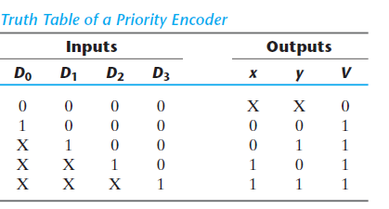
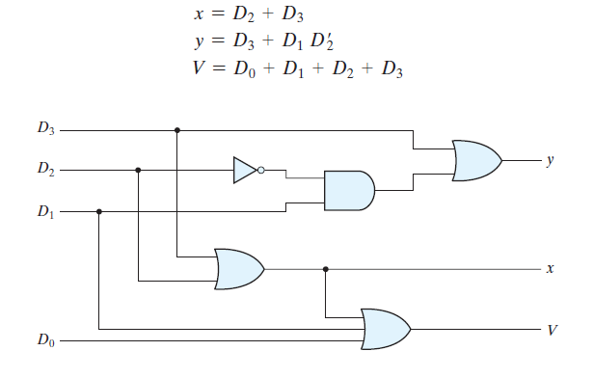
Priority Encoders
Boolean Expressions
Logic Diagram

Slide 16
Multiplexers
A multiplexer has
N control inputs(Select lines)
2^{N} data inputs
1 output
A multiplexer routes (or connects) the selected data input to the output.
The value of the control inputs determines the data input that is selected.

Slide 17
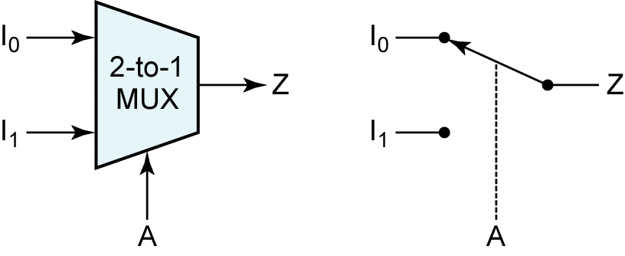
Multiplexers
Data
inputs
Z = A′.I₀ + A.I₁
Control
input

Slide 18
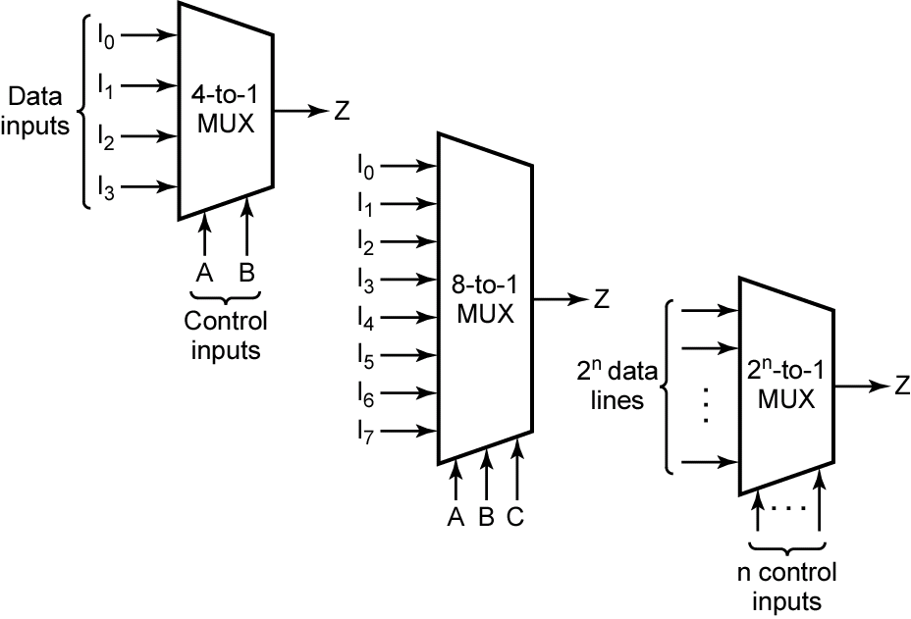
Multiplexers
A | B | F
0 | 0 | I₀
0 | 1 | I₁
1 | 0 | I₂
1 | 1 | I₃
MSB
LSB
Z = A′.B'.I₀ + A'.B.I₁ + A.B'.I₂ + A.B.I₃

Slide 19
Multiplexers
A | B | C | F
0 | 0 | 0 | I₀
0 | 0 | 1 | I₁
0 | 1 | 0 | I₂
0 | 1 | 1 | I₃
1 | 0 | 0 | I₄
1 | 0 | 1 | I₅
1 | 1 | 0 | I₆
1 | 1 | 1 | I₇
MSB
LSB
Z = A′.B'.C'.I₀ + A'.B'.C.I₁ + A'.B.C'.I₂ + A'.B.C.I₃ +
A.B'.C'.I₀ + A.B'.C.I₁ + A'.B.C'.I₂ + A.B.C.I₃

Slide 20
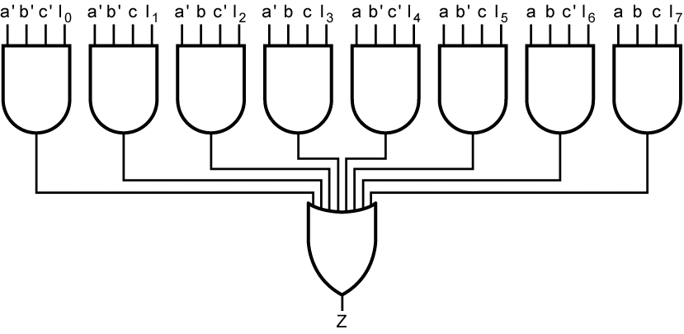
Multiplexers
Logic Diagram of 8x1 Multiplexer

Slide 21
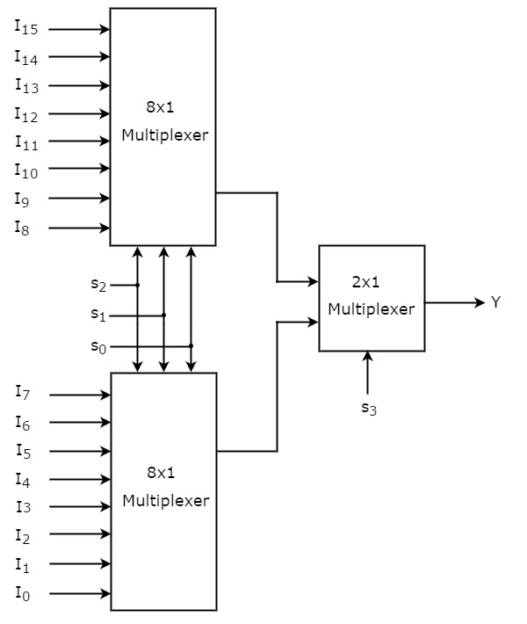
16x1 MULTIPLEXER USING 8X1 MUX

Slide 22
Demultiplexers
A demultiplexer has
N control inputs
1 data input
2^{N} outputs
A demultiplexer routes (or connects) the data input to the selected output.
The value of the control inputs determines the output that is selected.
A demultiplexer performs the opposite function of a multiplexer.

Slide 23
Demultiplexers
Out₀
W
W = A'.B'.I
Out₁
X
X = A.B'.I
I
In
Y
Out₂
Z
Y = A'.B.I
Out₃
S₁
S₀
Z = A.B.I
A
B
A | B | W | X | Y | Z
0 | 0 | I | 0 | 0 | 0
0 | 1 | 0 | I | 0 | 0
1 | 0 | 0 | 0 | I | 0
1 | 1 | 0 | 0 | 0 | I

Slide 24
Designing logic circuits using multiplexers
using an n-input Multiplexer
Use an n-input multiplexer to realize a logic circuit for a function with n minterms.
m = 2^{n}, where m = # of variables in the function
Each minterm of the function can be mapped to an input of the multiplexer.
For each row in the truth table, for the function, where the output is 1, set the corresponding input of the multiplexer to 1.
That is, for each minterm in the minterm expansion of the function, set the corresponding input of the multiplexer to 1.
Set the remaining inputs of the multiplexer to 0.

Slide 25
Designing logic circuits using multiplexers
Using an (n / 2)-input Multiplexer
Use an (n / 2)-input multiplexer to realize a logic circuit for a function with n minterms.
m = 2^{n}, where m = # of variables in the function
Group the rows of the truth table, for the function, into (n / 2) pairs of rows.
Each pair of rows represents a product term of (m – 1) variables.
Each pair of rows can be mapped to a multiplexer input.
Determine the logical function of each pair of rows in terms of the m^{th} variable.
If the m^{th} variable, for example, is x, then the possible values are x, x', 0, and 1.

Slide 26
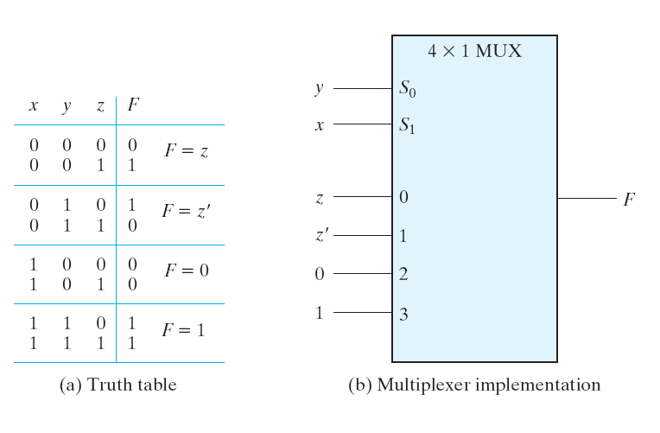
Using an (n / 2)-input Mux
Example: F(x,y,z) = Σm(1, 2, 6, 7)

Slide 27
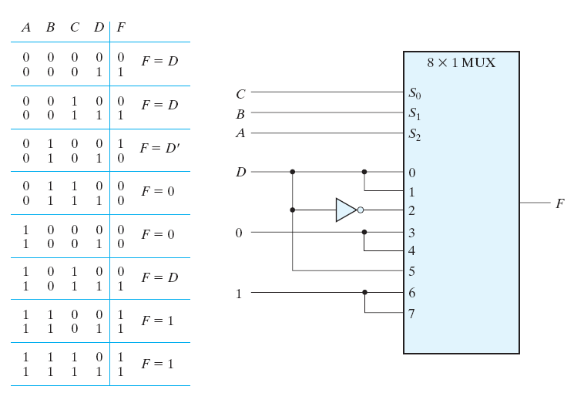
Using an (n / 2)-input Mux
Example: F(A,B,C,D) = Σm(1,3,4,11,12,13,14,15)

Slide 28
QUESTIONS:
Design a 16x1 Multiplexer using 2x1 Multiplexer.
Using an 8-to-1 multiplexer, design a logic circuit to realize the following Boolean function F(A,B,C) = Σm(2, 3, 5, 6, 7)
Using an 4-to-1 multiplexer, design a logic circuit to realize the following Boolean function F(A,B,C) = Σm(0,1, 3, 5, 6, 7)
Design a 4 bit Prime number detector.
Design a BCD to Gray Code Converter.

Slide 29
THANK YOU

